Slide 1
CERA
Curriculum Embedded Reading Assessment

Slide 2
Three (3) CERA Sections
Annotations
Comprehension
Process

Slide 3
Three Criteria
Notice Reading
Focus on Reading
Taking Control of Reading

Slide 4
Mark Twain's "Two Ways of Seeing a River"
Read the first paragraph
Annotate as you read

Slide 5
Annotations: Taking Control of Reading
A variety of marks for varying purposes, such as highlights, circles, underlines.
Purposeful marking of main ideas, text signals.
Purposeful comments that clarify, ask and answer questions, make connections, summarize.

Slide 6
Read the remaining paragraphs
"Two Ways of Seeing a River"

Slide 7
Comprehension
In your own words, write a short summary (one or two sentences) of this piece.
At what stage of his river experience does Twain see beauty of the river?
What does Twain lose after he learned to read the river as a navigator?
What does Twain gain by learning to read the river as a navigator?
Why does Twain pity the doctor?

Slide 8
Comprehension: Taking Control of Reading
Summary shows understanding of the main ideas and may connect to larger themes.
The answers to the comprehension questions offer evidence of a clear understanding of the passage.

Slide 9
process

Slide 10
As you were reading . . .
What kinds of things were happening in your mind as you read this?
What did you do that helped you to understand the reading?
What questions or problems do you still have with this piece?

Slide 11
Self-assessment (part of process)
How easy or difficult was this piece for you? (choose one)
Pretty easy
Not too hard
Pretty hard
Too hard
How well would you say you understand this piece?

Slide 12
Process: Taking Control of Reading
Process responses use reading vocabulary to specifically describe reading processes. Responses relate to marks and comments on the text and demonstrate the use of multiple strategies to solve problems.
Taken together, responses demonstrate student is aware of confusions and able to apply strategies to get back on track.

Slide 13
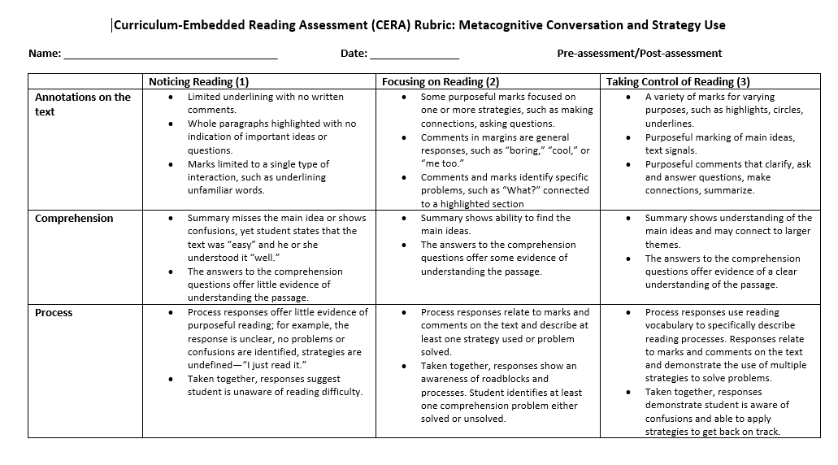
CERA Rubric

